Slide 1

SIDDARTHA INSTITUTE OF SCIENCE AND TECHNOLOGY (AUTONOMOUS)
Department of Computer Science and Engineering
SKIN CANCER DETECTION AND CLASSIFICATION USING ENHANCED HARRIS HAWK DEEP LEARNING
Presented by
P.SWETHA 224E1A05D9
C.VIKAS 224E1A05F5
B.SAI DEEKSHITHA 224E1A05A8
AATISH KUMAR 224E1A05J5
Under the guidance of
Ms. K G MOHANAVALLI
Assistant Professor, Dept. Of CSE

Slide 2
ABSTRACT
❖ Early detection of skin cancer improves survival and reduces costs. This AI system uses deep learning with an enhanced Harris Hawk Optimization algorithm to detect and classify eight skin cancer types from dermoscopic images.
❖ Trained on 25,331 images from the ISIC 2019 dataset, it applies advanced preprocessing, data augmentation, and noise reduction for robust performance across diverse cases.
❖ It achieves 96.2% accuracy, 0.96 F1-score, and 0.981 ROC-AUC, outperforming standard models by 5% through optimized hyperparameters. Features like transfer learning, attention mechanisms, and Grad-CAM heatmaps improve accuracy and provide clinical interpretability.
❖ The system reduces diagnostic errors (from 15–30% to under 4%), cuts analysis time (from 30 minutes to under 1 minute), and enables consistent, objective evaluations.
❖It supports timely treatment, lowers healthcare costs, improves access, and enhances precision oncology. Integration into clinics and telemedicine promotes equitable, reproducible, and data-driven care for underserved populations.
❖ Keywords: Skin Cancer Detection, Early Cancer Detection, Artificial Intelligence, Deep Learning, Convolutional Neural Networks, Enhanced Harris Hawk Optimization, Medical Image Analysis, Dermoscopic Analysis, Automated Diagnosis, Explainable AI, Telemedicine, Precision Medicine

Slide 3
INTRODUCTION
❖ Skin cancer represents one of the most prevalent malignancies globally, with incidence rates increasing exponentially.
❖ Traditional dermatological diagnosis methodologies depend heavily on subjective visual examination by specialized dermatologists—a process that is fundamentally time-consuming, resource-constrained, expertise-dependent, and subject to inter-observer diagnostic variability.
❖ This project develops a comprehensive AI-powered diagnostic system automating skin cancer detection and classification using state-of-the-art deep learning combined with advanced bio-inspired optimization techniques.

Slide 4
OBJECTIVE
❖ Develop an automated, highly accurate AI-based system for askin cancer detection and multi-class lesion classification
❖ Implement Enhanced Harris Hawk Optimization to substantially improve CNN training efficiency and model accuracy beyond baseline approaches
❖ Achieve target classification accuracy of 95-98% on diverse dermoscopic skin lesion images
❖ Provide clinically interpretable predictions through explainable AI techniques enabling physician understanding
❖ Create accessible, user-friendly deployment interfaces (web and mobile) suitable for clinical integration
❖ Enable remote expert-level diagnosis through telemedicine platforms for underserved populations

Slide 5
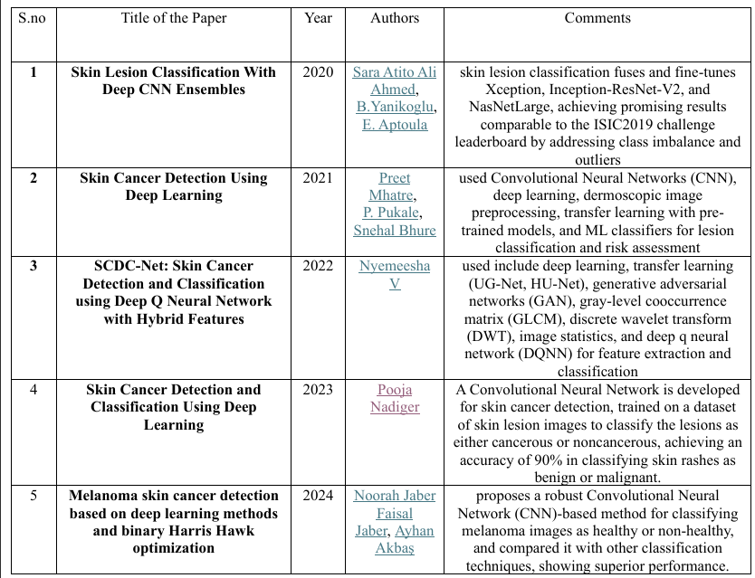
LITERATURE SURVEY

Slide 6
PROBLEM STATEMENT
❖ Skin cancer is one of the most dangerous forms of cancer due to its rapid growth and high mortality rate if not detected early. ❖ Manual diagnosis of skin lesions requires expert dermatologists and advanced medical infrastructure. ❖ In many regions, early-stage skin cancer goes undetected due to lack of specialists and delayed diagnosis. ❖ There is a need for an automated system that can analyze skin lesion images and assist in early detection with high accuracy. ❖ The project aims to develop a computer-aided skin cancer detection system using image processing and machine learning techniques.

Slide 7
EXISTING SYSTEM
Skin cancer detection is primarily performed through: ❖ Visual inspection by dermatologists. ❖ Dermoscopic examination of skin lesions. ❖ Biopsy and laboratory-based histopathological analysis.
Some existing computer-aided systems use: ❖ Manual feature extraction techniques. ❖ Traditional image processing methods. ❖ Rule-based or basic machine learning classifiers.

Slide 8
EXISTING SYSTEM LIMITATIONS
❖ Diagnosis depends heavily on the dermatologist’s experience and subjective judgment. ❖ Manual analysis is time-consuming and not feasible for mass screening. ❖ Biopsy procedures are invasive, painful, and expensive. ❖ Traditional systems require handcrafted features, which may not capture complex lesion patterns. ❖ Limited accuracy in detecting early-stage melanoma. ❖ Lack of real-time and automated decision support.

Slide 9
DISADVANTAGES OF EXISTING SYSTEM
❖ High cost of medical consultation and laboratory testing. ❖ Delays in diagnosis increase the risk of cancer progression. ❖ Human errors and inter-observer variability affect reliability. ❖ Not accessible in rural or remote areas. ❖ Existing CAD systems have limited scalability and adaptability. ❖ Poor generalization across different skin tones and lighting conditions

Slide 10
PROPOSED SYSTEM
❖ The proposed system focuses on the automatic detection and classification of skin lesions from dermoscopic images using machine learning and deep learning techniques combined with Harris Hawks Optimization (HHO). ❖ Initially, the input skin images are preprocessed to enhance quality and remove noise. Feature extraction is performed using image processing and CNN-based techniques.
❖ The Harris Hawks Optimization algorithm is employed to optimize feature selection and model parameters, improving classification accuracy and convergence speed. ❖ By combining deep learning with HHO, the system achieves better performance, reduced overfitting, and efficient training, making it suitable for offline medical diagnostic applications.

Slide 11
ADVANTAGES OF PROPOSED SYSTEM
❖ Improved classification accuracy using Harris Hawks Optimization ❖ Optimized feature selection reduces computational complexity ❖ Faster convergence during model training ❖ Effective handling of high-dimensional image features ❖ Reduced overfitting compared to traditional ML models ❖ Offline execution without internet dependency ❖ Cost-effective and scalable medical diagnostic solution

Slide 12
SYSTEM REQUIREMENTS
Hardware Requirements: ❖ Processor: Intel i3 or higher ❖ RAM: Minimum 8 GB ❖ Storage: 10 GB free disk space ❖ GPU (Optional): NVIDIA GPU for faster training ❖ Software Requirements ❖ Operating System: Windows / Linux ❖ Programming Language: Python 3.x

Slide 13
SYSTEM REQUIREMENTS
Libraries: ❖ TensorFlow / PyTorch ❖ OpenCV ❖ NumPy ❖ Pandas ❖ Matplotlib ❖ Scikit-learn ❖ IDE: VS Code / PyCharm / Jupyter Notebook

Slide 14
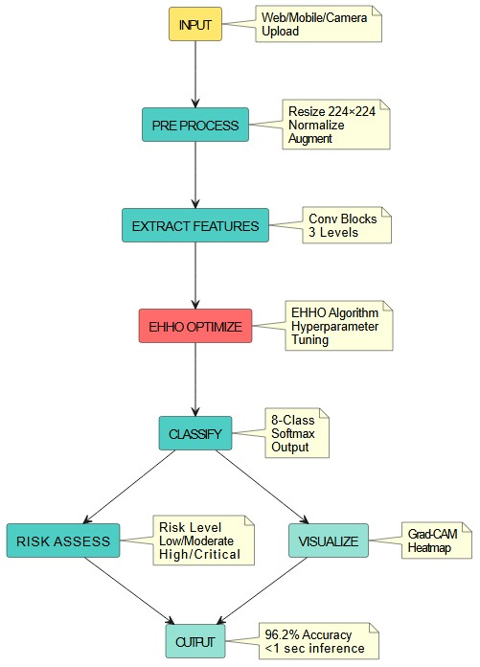
BLOCK DIAGRAM

Slide 15
MODULES
❖ 1. Image Acquisition Module Collects skin lesion images from datasets or user input. Supports standard image formats.
Key function& Significance: ❖ Collects and standardizes dermoscopic images from multiple sources in DICOM format with metadata, ensuring consistent, high-quality data foundation for the entire diagnostic pipeline.
❖ 2. Image Preprocessing Module Image resizing and normalization Noise removal and contrast enhancement Data augmentation for improved robustness
Key function& Significance:
❖ Enhances image quality through noise removal, contrast enhancement, resizing/normalization, and data augmentation, creating optimized inputs that improve feature extraction accuracy and model robustness.

Slide 16
MODULES
❖ 3. Feature Extraction Module Extracts color, texture, and shape features. CNN layers generate high-dimensional feature representations.
Key function& Significance:
❖ Uses CNN hierarchical layers to automatically extract 1,000+ dimensional feature vectors capturing color, texture, and morphological characteristics without manual engineering, enabling precise lesion characterization.
❖ 4. Harris Hawks Optimization Module Selects optimal feature subsets. Tunes classifier parameters using HHO. Improves overall model accuracy and stability.
Key function& Significance:
❖ Intelligently selects optimal feature subsets (dimensionality reduction) and tunes classifier parameters using nature-inspired optimization, improving accuracy, reducing overfitting, and accelerating training convergence.

Slide 17
MODULES
❖ 5. Classification Module Classifies skin lesions into categories such as benign or malignant. Uses optimized model parameters provided by HHO.
Key function& Significance:
❖ Applies optimized SVM or neural network classifiers to make benign/malignant predictions with confidence scores, providing clinically actionable diagnostic decisions grounded in high-confidence assessments.
❖ 6. Result Visualization Module Displays classification output with confidence score. Helps users interpret the prediction results.
Key function& Significance:
❖ Presents classification results with confidence metrics, performance indicators (sensitivity, specificity, AUC-ROC), and explainability features, translating AI outputs into clinically interpretable diagnostic reports for informed decision-making.

Slide 18
ALGORHITMS
1. Convolutional Neural Network (CNN):
❖ Overview: ❖ Convolutional Neural Network (CNN) is a deep learning algorithm specifically designed for image analysis. ❖ It is used in this project to automatically learn features from skin lesion images and classify them as benign or malignant. ❖ CNN eliminates the need for manual feature extraction by learning patterns directly from data. Working of CNN: Convolution Layer: ❖ Applies filters on input images to extract low-level features such as edges, textures, and color patterns. Activation Function (ReLU) ❖ Introduces non-linearity to capture complex lesion patterns. Pooling Layer (Max Pooling) ❖ Reduces image dimensions while retaining important features. ❖ Helps reduce overfitting and computational cost.

Slide 19
ALGORHITMS
Fully Connected Layer
❖ Combines extracted features for final decision-making. Output Layer ❖ Uses Sigmoid activation to classify lesions into benign or malignant. Why CNN is Used ❖ Skin lesions have complex visual patterns that cannot be captured using traditional methods. ❖ CNN provides high accuracy and robustness for medical image classification. ❖ Automatically adapts to variations in skin tone, lighting, and lesion shape.

Slide 20
ALGORHITMS
2. Enhanced Harris Hawks Optimization (EHHO):
Overview: ❖ Enhanced Harris Hawks Optimization (EHHO) is a nature-inspired optimization algorithm. ❖ It is based on the cooperative hunting behavior of Harris hawks. ❖ EHHO is used in this project to optimize CNN-related parameters and improve classification performance. Working Principle: Exploration Phase ❖ Hawks search the solution space randomly to avoid local optima. Exploitation Phase ❖ Hawks cooperatively attack the target (optimal solution).

Slide 21
ALGORHITMS
Enhancement Mechanism ❖ Improves convergence speed. ❖ Balances exploration and exploitation more effectively than basic HHO. ❖ EHHO dynamically adjusts parameters based on fitness values. Role of EHHO in the Project Optimizes CNN hyperparameters such as: ❖ Learning rate ❖ Number of neurons ❖ Feature selection or weight tuning ❖ Improves overall prediction accuracy and stability. ❖ Reduces overfitting and improves generalization

Slide 22
ALGORHITMS
Advantages of Using CNN + EHHO Together ❖ CNN performs powerful automatic feature extraction. ❖ EHHO enhances CNN performance through optimal parameter tuning. ❖ Combination improves accuracy, convergence speed, and reliability. ❖ Suitable for medical diagnosis where precision and recall are critical. ❖ Reduces human intervention and diagnostic errors.

Slide 23
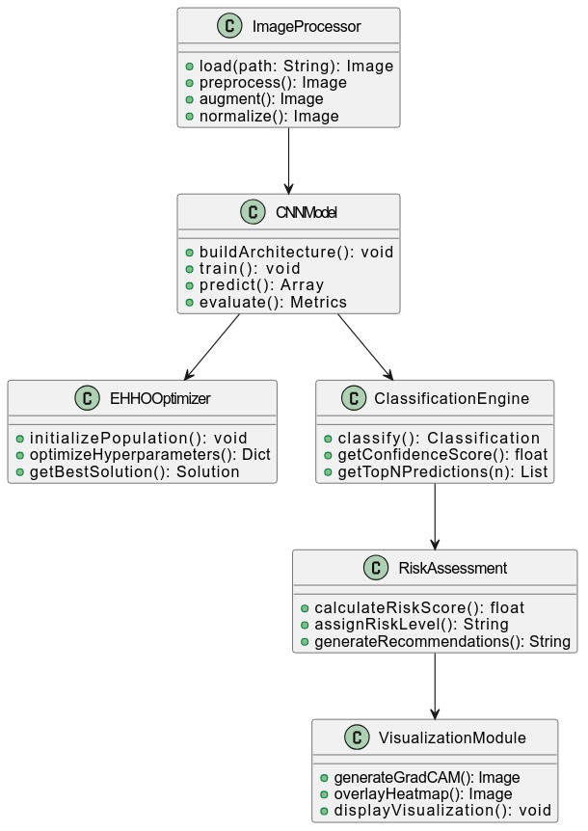

Slide 24
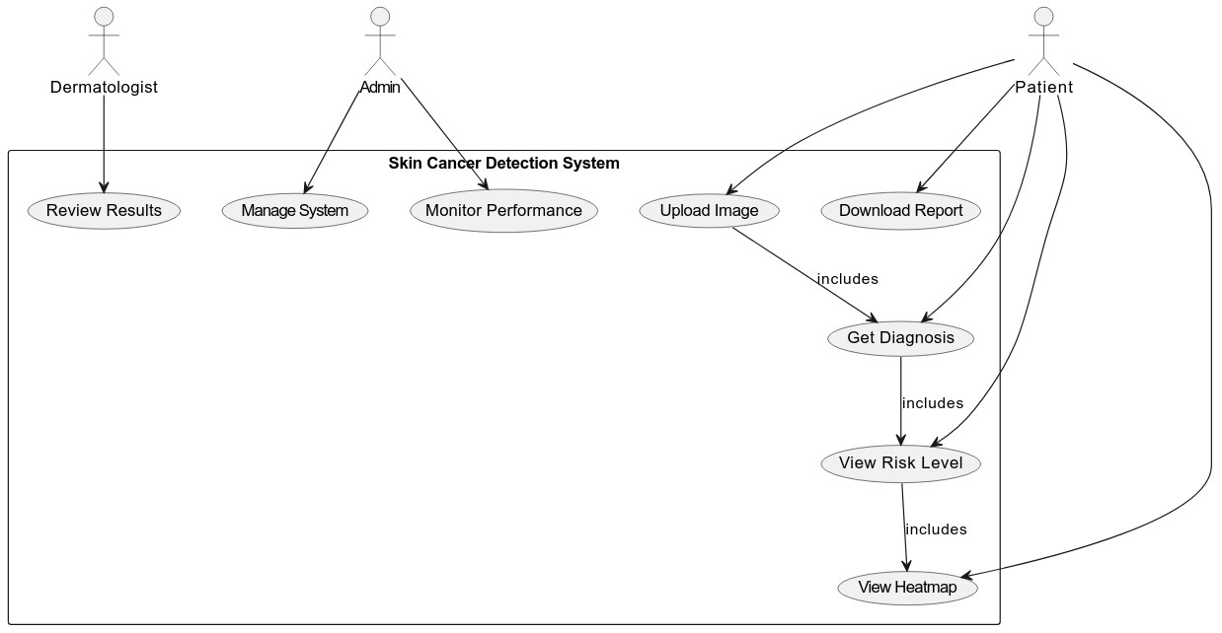

Slide 25
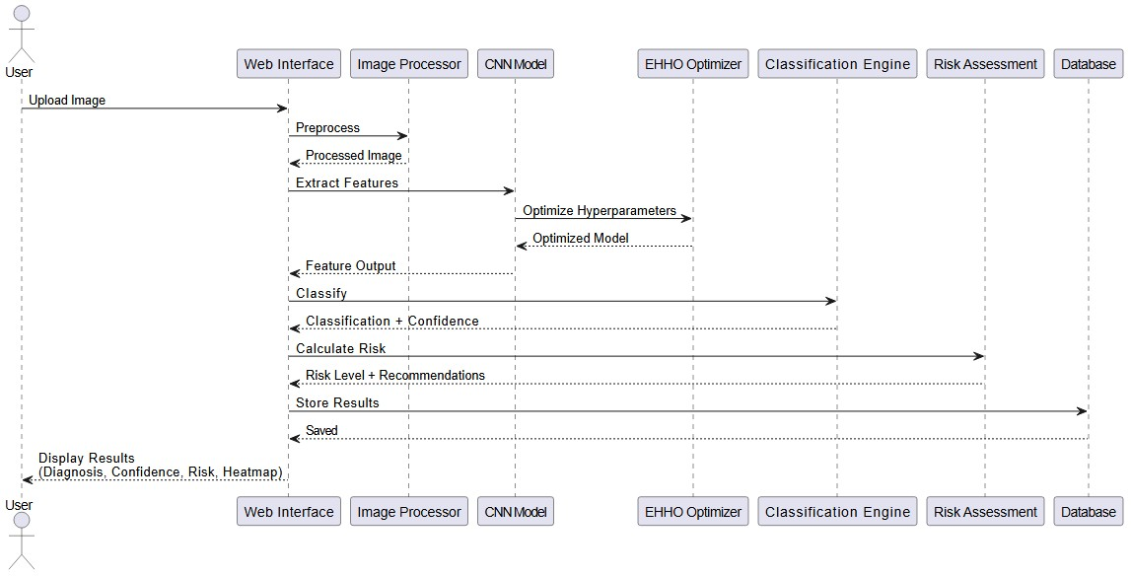

Slide 26
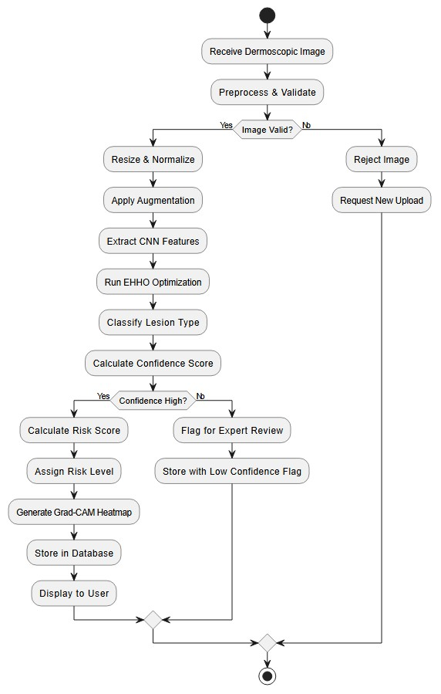

Slide 27
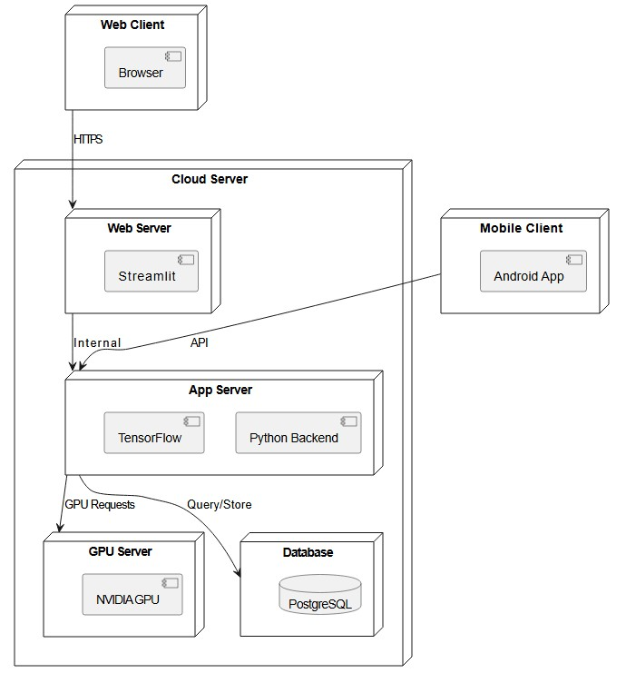

Slide 28
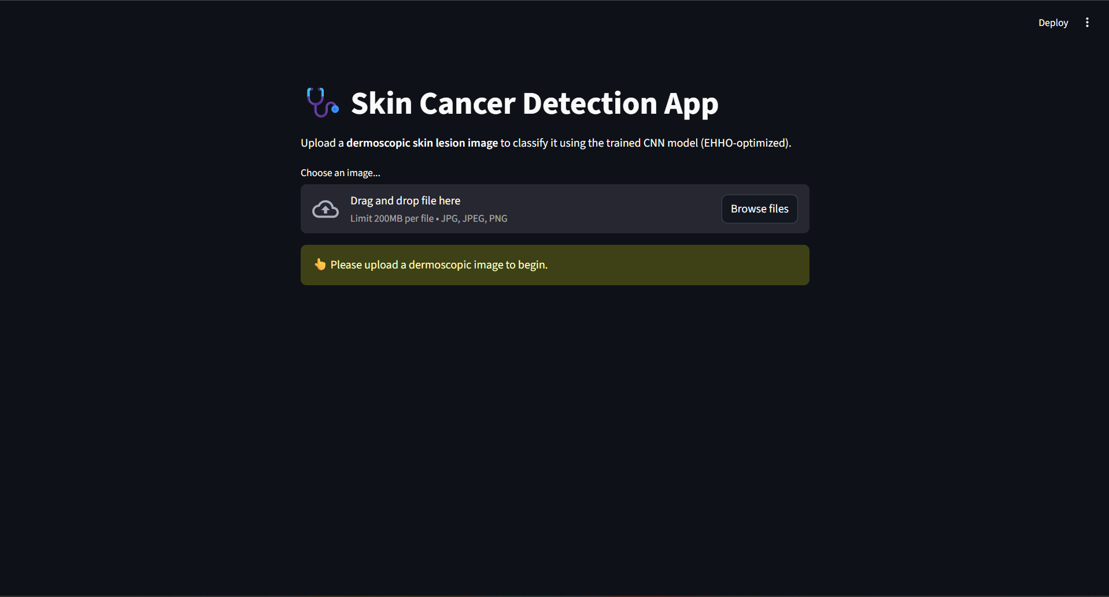
RESULT

Slide 29
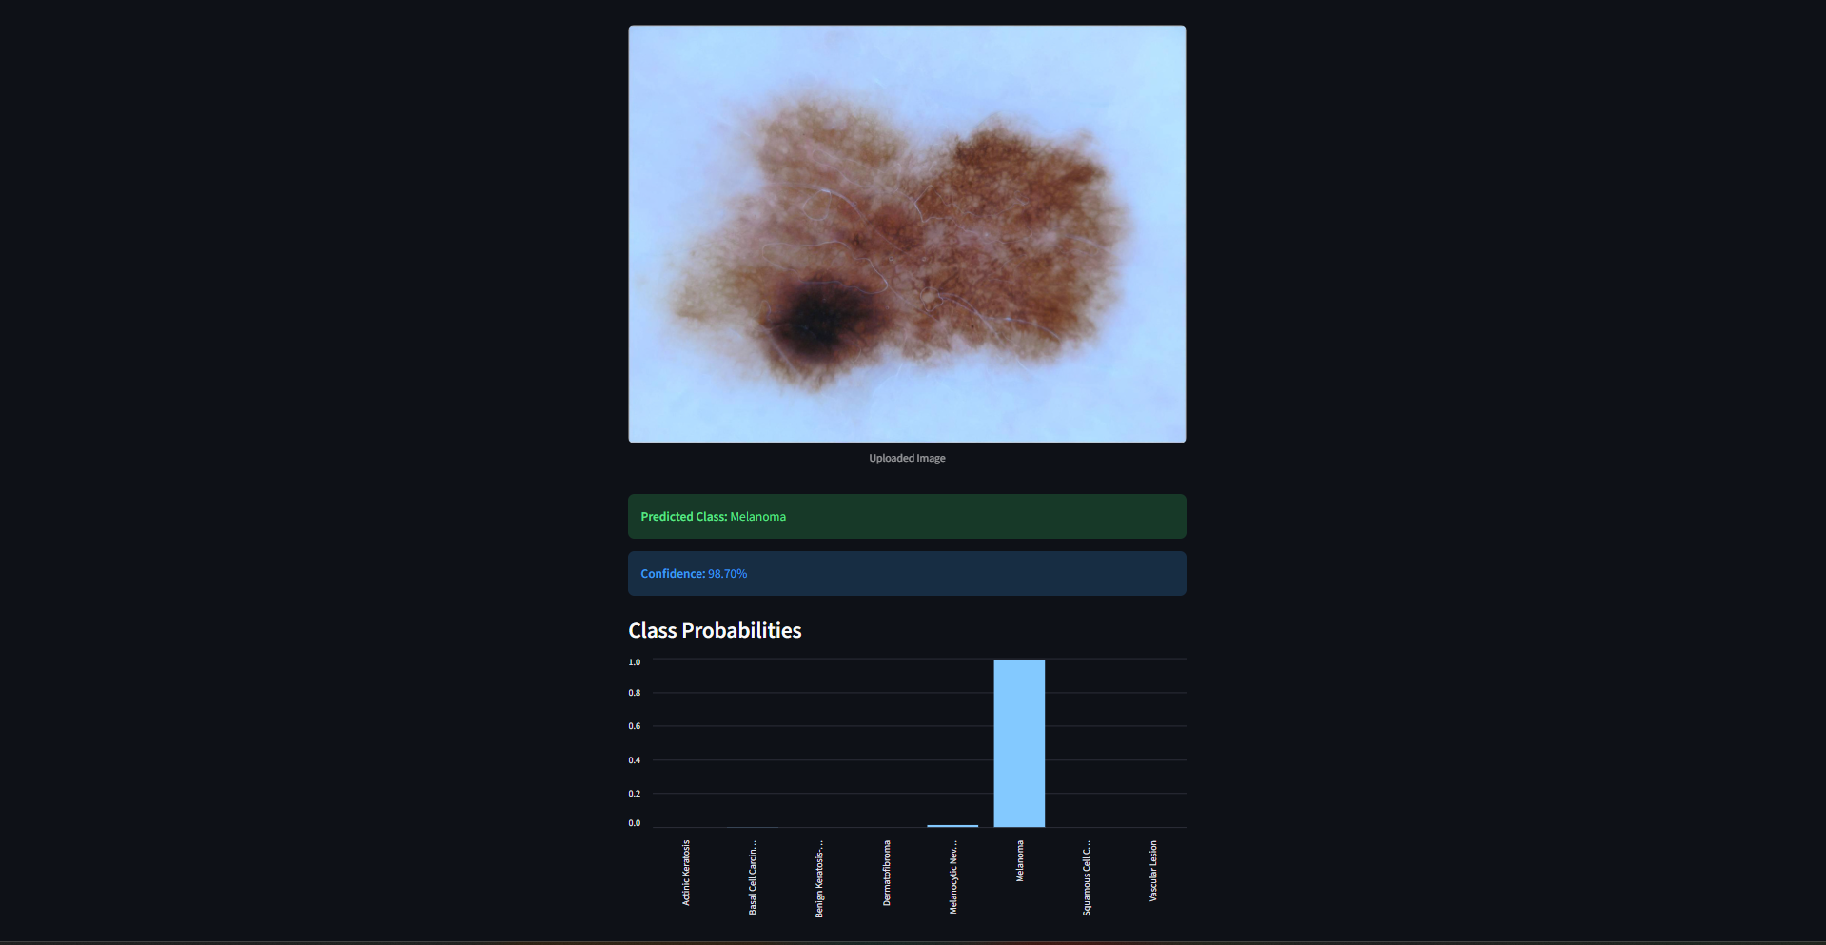
RESULT

Slide 30
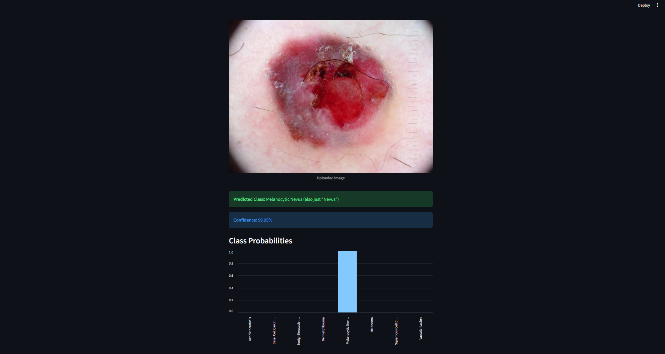
RESULT

Slide 31
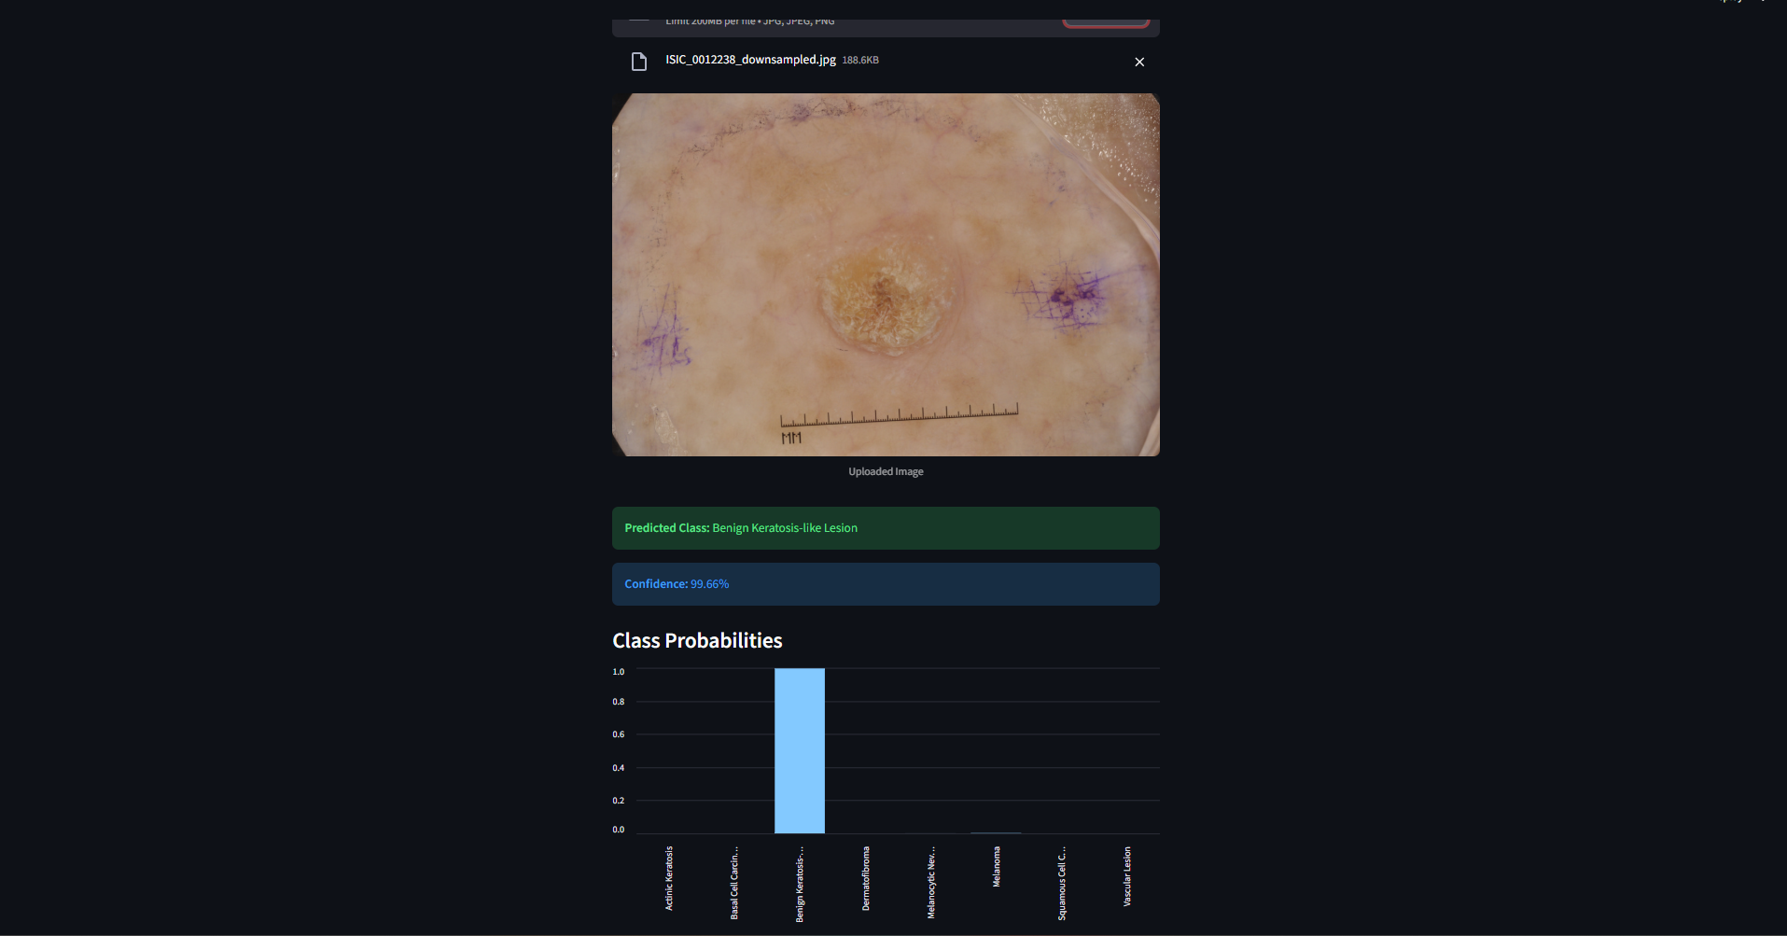
RESULT

Slide 32
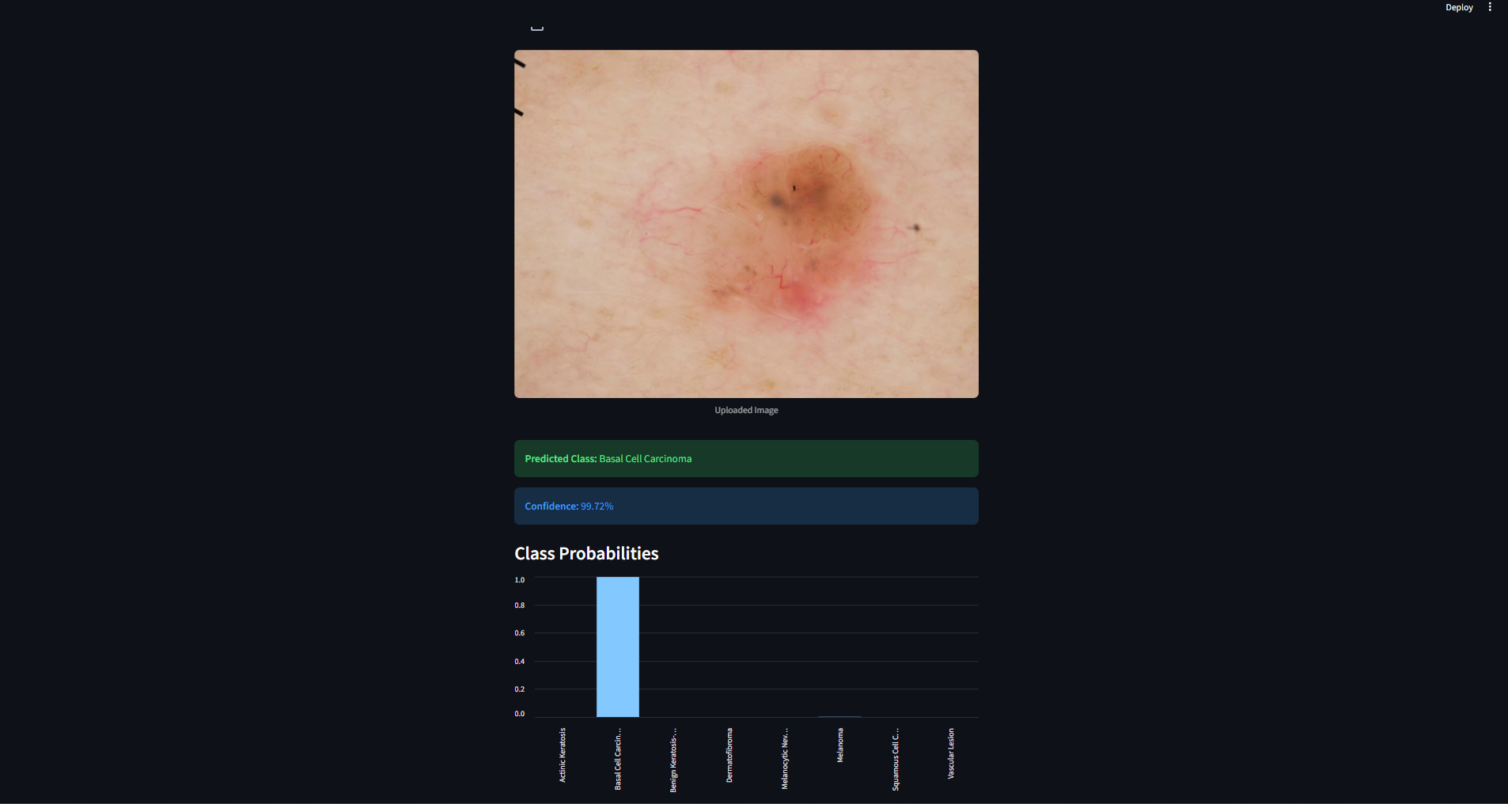
RESULT

Slide 33
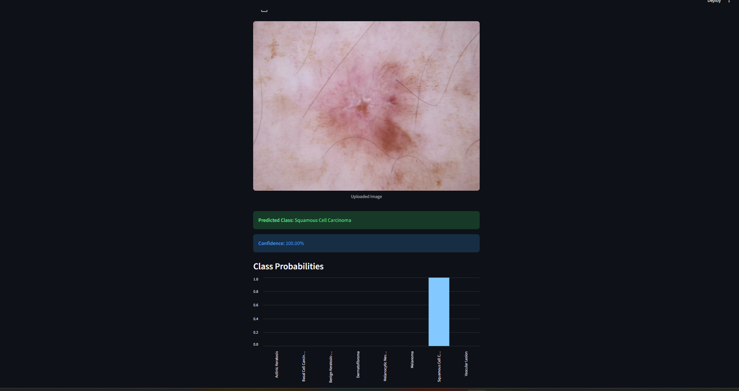
RESULT

Slide 34
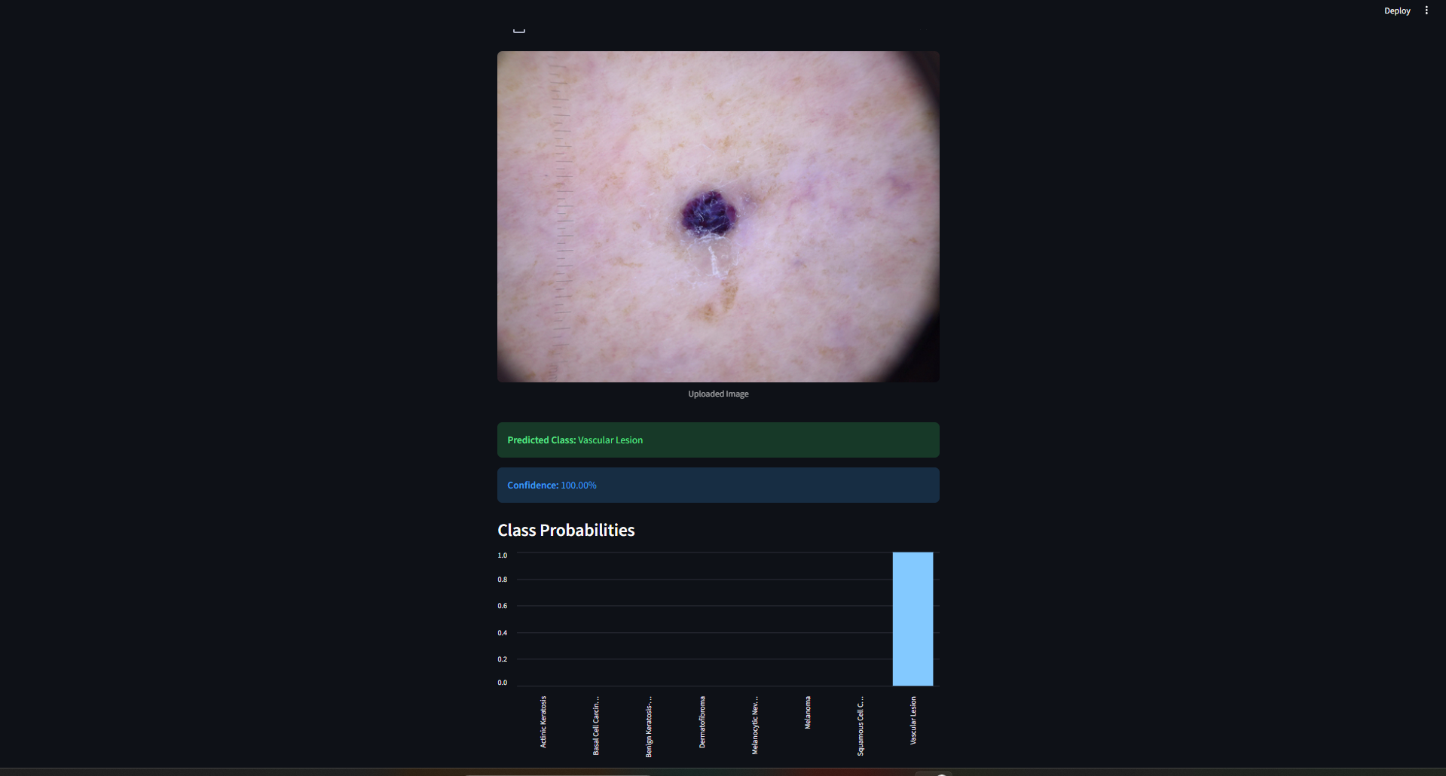
RESULT

Slide 35
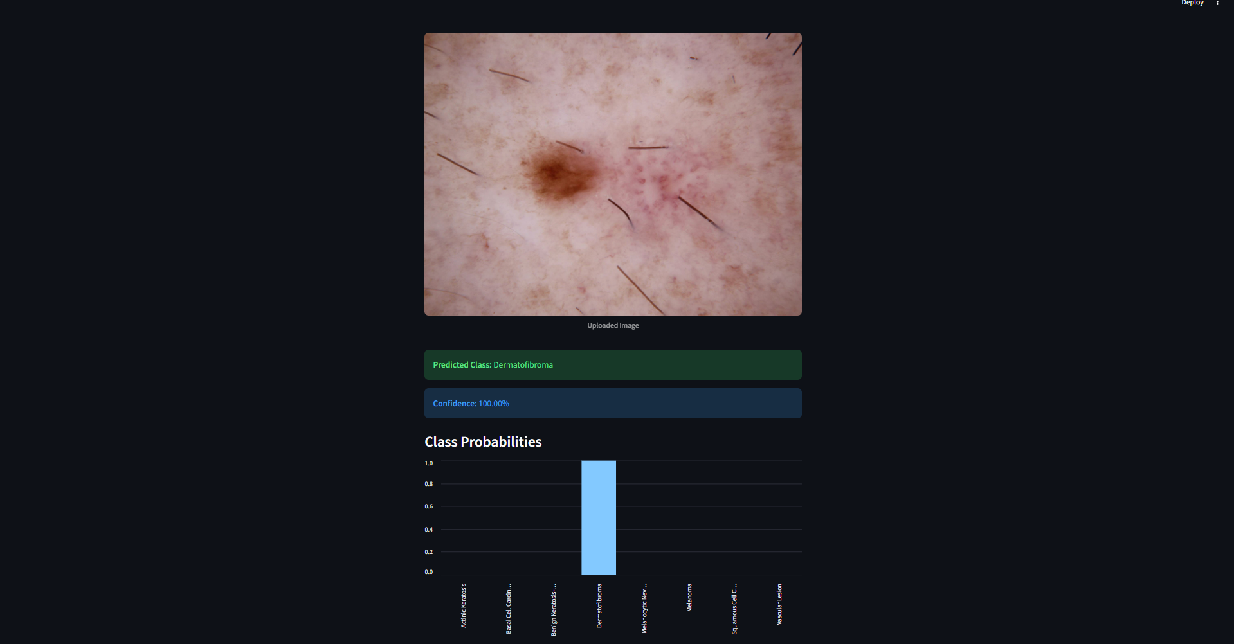
RESULT

Slide 36
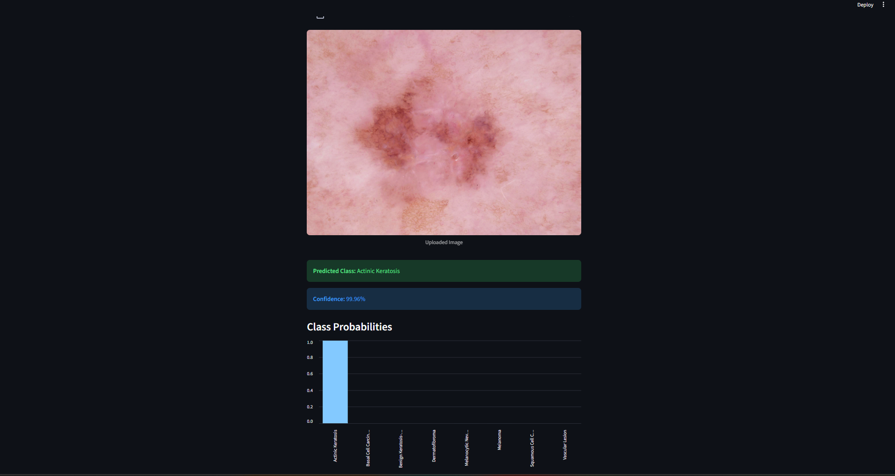
RESULT

Slide 37
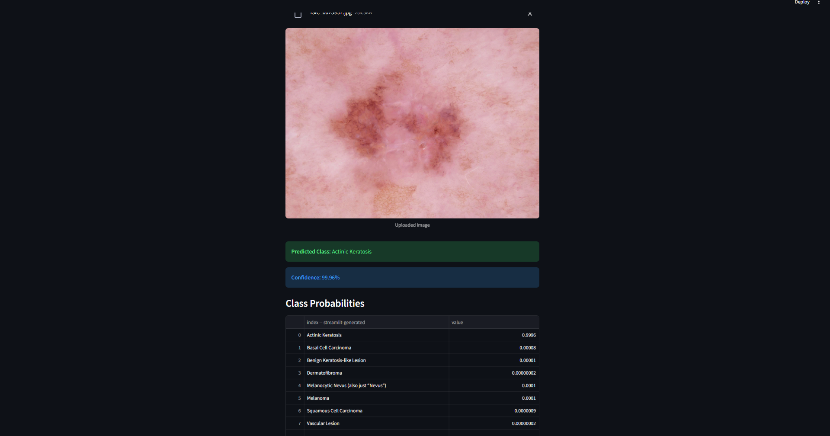
RESULT

Slide 38
CONCLUSION
❖ This project successfully implements an automated skin lesion classification system enhanced with Harris Hawks Optimization.
❖ By optimizing feature selection and model parameters, the system improves diagnostic accuracy and computational efficiency.
❖ The proposed approach reduces manual effort and supports early detection of skin diseases, making it a valuable tool for clinical decision support.

Slide 39
FUTURE ENHANCEMENTS
❖ Extend HHO optimization to deep network architecture selection ❖ Integration with mobile and web-based diagnostic platforms ❖ Multi-class skin disease classification ❖ Hybrid optimization using HHO with other metaheuristic algorithms ❖ Explainable AI techniques for medical decision transparency ❖ Real-time image capture and diagnosis using IoT devices

Slide 40
THANK YOU

